Slide 1
Senior Trip 2023
Information

Slide 2
Where & When
Disney World, Orlando, FL
February 15-21, 2023- missing 4 days of school

Slide 3
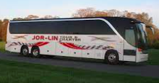
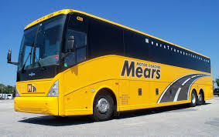
Airport Transportation
To/from BWI- provided by Jor-Lin Tour and Charter. More details to follow.
To/from MCO- provided by Mears Transportation. More details to follow.

Slide 4
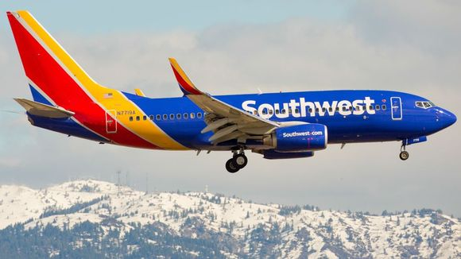
Air Travel- Southwest
Wednesday, Feb. 15, 2023
Departing flight from BWI
Tuesday, Feb. 21, 2023
Departing flight from MCO
Reservations will be made for the entire group when the February dates open.

Slide 5
Accommodations
Pop Century Resort
Budget friendly
Cafeteria-style eating
Buses or Skyliner transportation to/from all theme parks on Disney property
Any charges incurred by the room will be the responsibility of the students in the room.

Slide 6
Accommodations
Students will sign up for their rooms in groups of 4.
Boys will room with boys; girls will room with girls.
Students in groups fewer than 4 will run the risk of being assigned to a room with other incomplete groups.

Slide 7
Extra Security
Since the rooms open to the outside (not into a hallway), we will hire extra security for the night. A security guard will be on duty from 11:45 p.m. to 6:00 a.m. at extra cost.
Students will be expected to remain in their assigned rooms until 6:00 a.m. once checked in by a chaperone at midnight.
If there is an emergency, students may tell the security guard or text a chaperone. It will be addressed accordingly.

Slide 8
Curfew
Will be imposed each night anytime between 10:00 p.m. and midnight.
Consideration will be given to park hours and events.
Individuals may be given a different curfew if behavior warrants it (late the night before, other infraction, extension for good behavior).

Slide 9
Park Hopper Pass
Will be distributed on Thursday morning in preparation for Y.E.S. program.
Y.E.S. program requires 100% participation from the group, provides a $200 discount on passes for each student.
3-hour program on Thursday, Feb. 16 at 8:00.
Program: Physics in Imagineering in Hollywood Studios.
Except for Y.E.S. program, students will not be in groups supervised by a chaperone; they will be permitted to make their own plans and come/go from hotel before curfew.

Slide 10
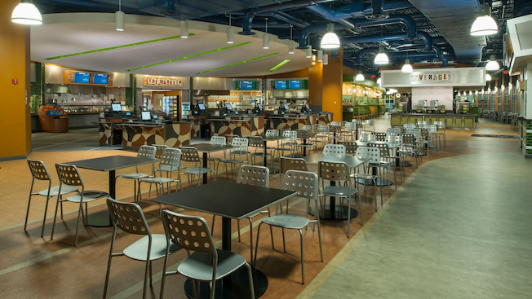
Food, Souvenirs, & Incidentals
Students will bring their own money for this and will be responsible for managing their money for the entire trip.
May spend as much or as little as they would like (or as their budget allows).
Groups may make dining reservations in advance at one of the many restaurants or experiences on Disney property keeping curfew in mind.
Any extra fees incurred at the airport (oversize/overweight luggage) will be the responsibility of the student.

Slide 11
Expectations of Behavior
Since this is a school trip, students will be expected to conduct themselves in a respectful manner at all times, which includes:
School rules for conduct will be in effect. Students will be required to sign a Code of Conduct in order to attend the trip and follow it.
Abiding by Disney property rules/signage- quiet hours, being mindful of others at all times, etc.
Obeying instructions from Disney and any transportation staff, as well as any adult chaperone on the trip.
Remembering that there will be families around us on vacation- no foul language, offensive behavior, etc.

Slide 12
Cost
Each student will pay $1500 to SA- airfare, hotel, transportation to/from airports, Park Hopper Pass, and extra security.
Each student will bring own spending money for food and souvenirs ($300 and up).

Slide 13
Sign Up!
A $100 deposit is required by April 14 (by spring break). This is non-refundable and can be turned into Mrs. Moore.
Then four $350 payments due May 2, June 1, September 6, and October 3.
You may also pay remaining $1400 at one time, which should be submitted by June 1.
Make checks payable to Sussex Academy.

Slide 14
Next Steps
Once deposit is paid, student will be added to the trip Schoology course. Important information will be posted here, including tasks students must complete in order to attend the trip. This will be available to parents who follow their student’s Schoology account. STUDENTS MUST COMPLETE TASKS ON SCHOOLOGY BY DUE DATES OR RUN THE RISK OF BEING DROPPED FROM THE TRIP.
Email or message Mrs. Messina with questions.
sara.messina@saas.k12.de.us

Slide 15
Looking Forward to Next Year
Will complete permission form and code of conduct in the fall.
There will be a parent/guardian meeting ahead of our departure next year. Date and time will be emailed by SA and messaged to students via Schoology.
There will also be a separate meeting during the school day for all students attending the trip before departure.

